Slide 1
Cricket Search Engine
Harsh Verma : HXV180001
Vatsalkumar: vrp140230
Surya Allah: sxa180109
Chandhya :cxt123730
Debargha Ghosh : dxg170014
Anugreh Raina : axr180055

Slide 2
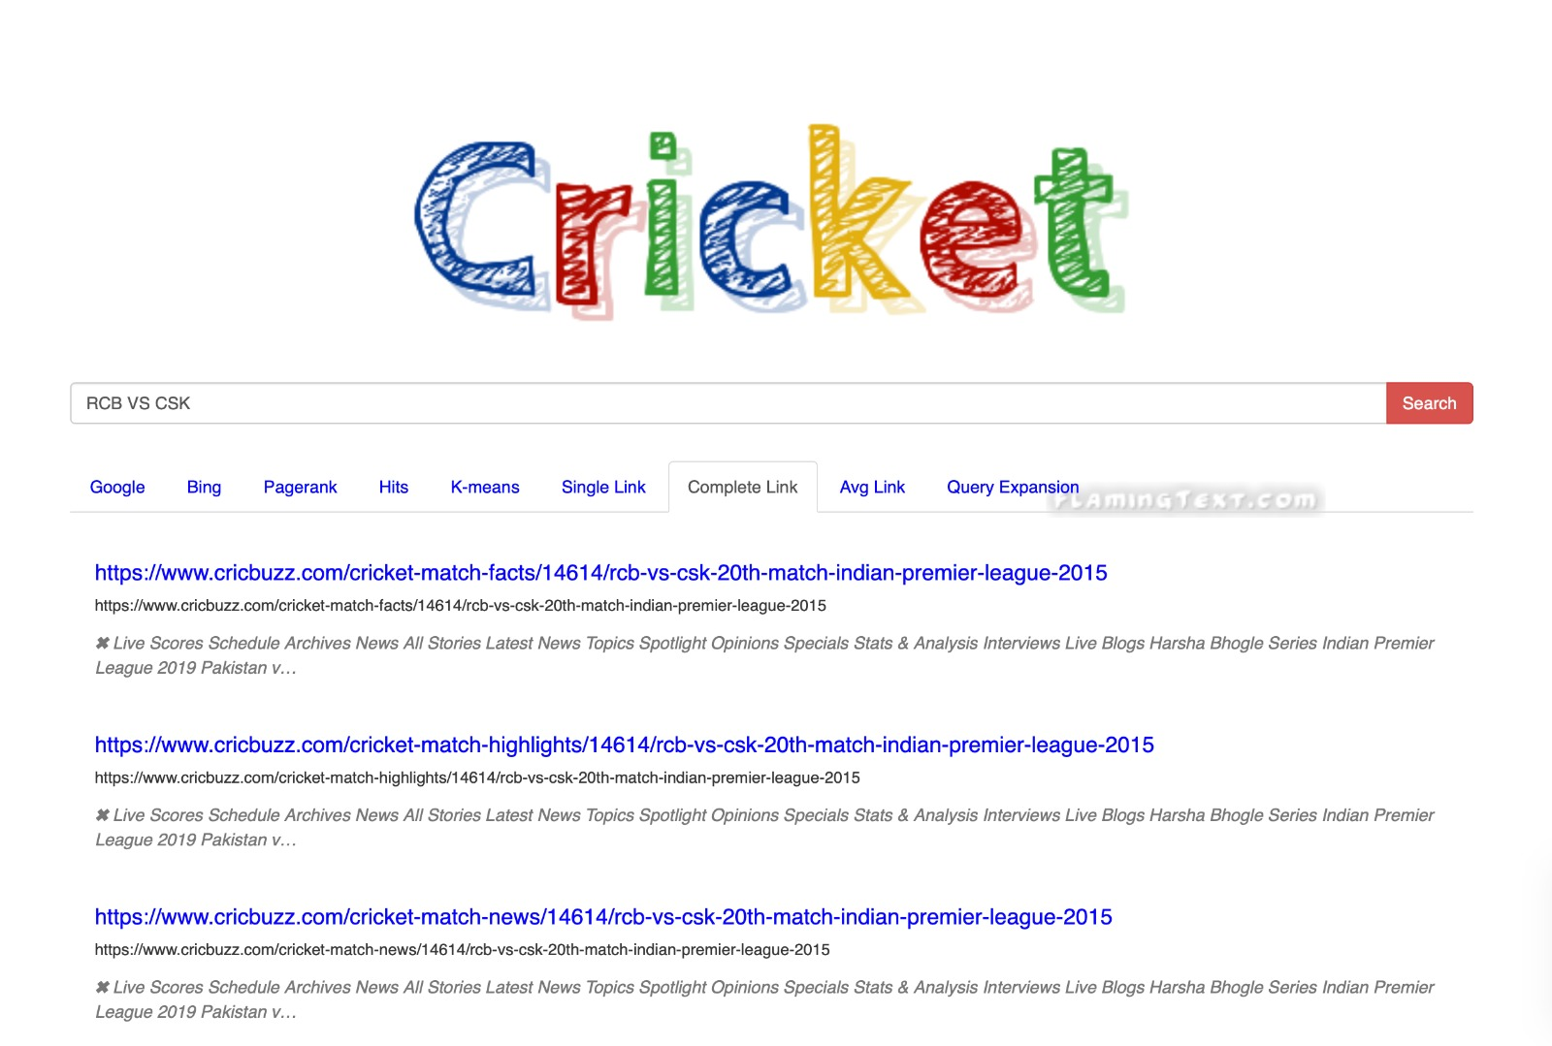

Slide 3
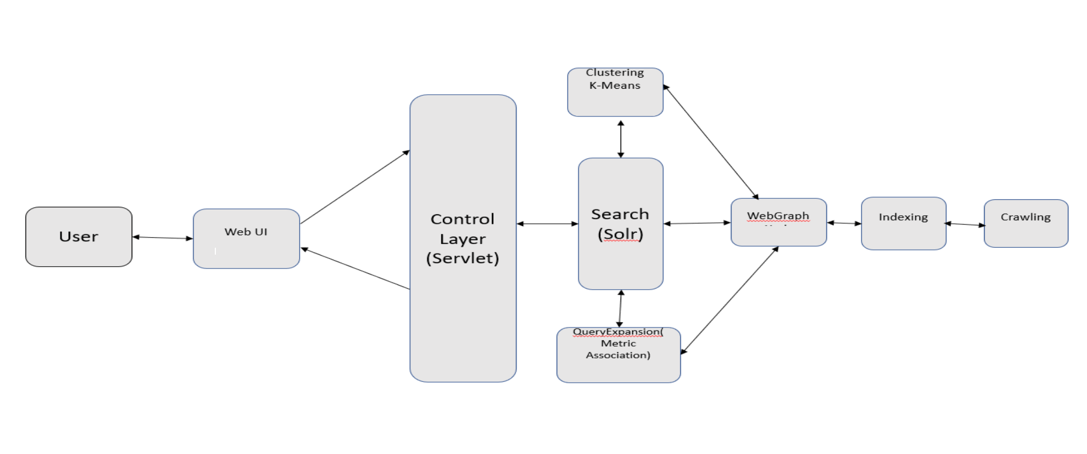
PROJECT ARCHITECTURE

Slide 4
CRAWLING
Presented By – Harsh verma

Slide 5
CRAWLING
Crawled more than 120,000+ web pages and content was fetched.
Used Apache Nutch 1.15 and Solr 7.3.1.
Nutch site.xml to point to core of indexer of solr. Data crawled was directly pushed to solr for indexing.
Regex was used to parse Urls and filters were applied.
CRAWLDB: it maintains the information about URLs such as the fetch status, fetching schedule, metadata, etc
LINKDB: For each URL, the LINKDB maintains the incoming and outgoing URLs for that URL which are further used to facilitate PAGE RANKING algorithm and the HITS algorithm
SEGMENTS: contains multiple subdirectories within it. During Crawling, the crawl script creates multiple directory to store information for Crawl Fetching, Crawl Content, Crawl Parsing, Parsed Data and Parsed Text

Slide 6
INDEXING
Presented By – Vatsal

Slide 7
INDEXING
For Indexing, I have used Apache Solr 7.3.1
Nutch created the 3 folders called linkdb, crawldb and segments. The crawldb is usedto generate the linkdbDump which contains the inlinks, outlinks FromUrl,
This is used to create the webgraph and then pageranking is done on this webgraph.
Now the hits are calculated using the python program and results are then sent to the UI from this module.

Slide 8
CLUSTERING
Presented By – Debargha

Slide 9
CLUSTERING
Used SkLearn library for K-means clustering
No of Clusters : 15
Taken data from segments created from nutch
Used results from solr to compare with the clustered data and returned top 15 webpages which are maximum of clusters

Slide 10
QUERY EXPANSION
Presented By – Surya & Anugreh

Slide 11
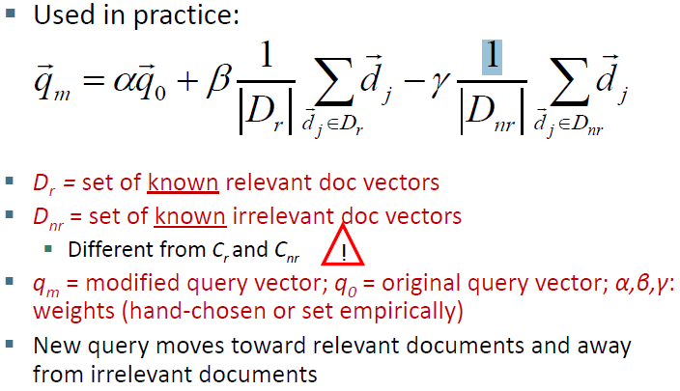
QUERY EXPANSION
Rochhio:

Slide 12
TYPES
Three types of clustering are:
Association cluster:
The idea is that stems which co-occur frequently inside documents have a synonymity association
Metric cluster:
The idea is that the stems which occur far apart in the document are less co-related to the terms that occur closer like in the same sentence.
Scalar cluster:
The idea is that two stems are more co-related if they have similar neighborhood.

Slide 13
GUI
Presented By – Chandhya

Slide 14






TECHNOLOGY STACK

Slide 15
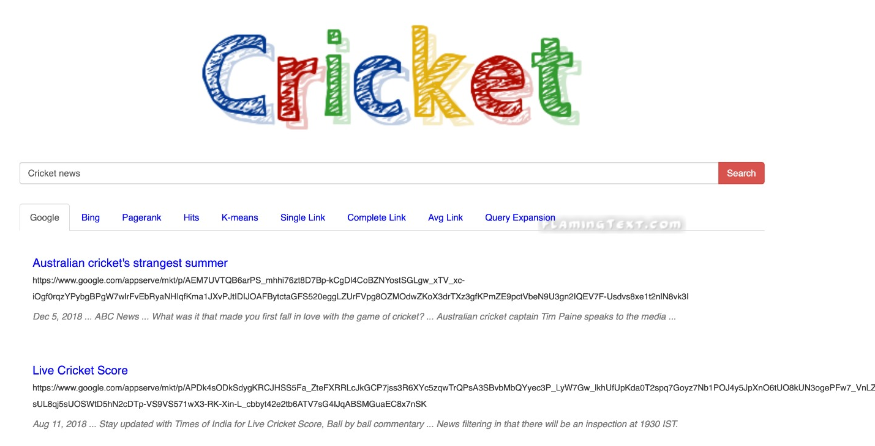
WEBPAGE
System Design:
Presentation Layer
Application Layer
Data Access Layer
Business Layer
Components:
The Logo
A search bar
Navigable tabs
REST API Callas - GET and POST requests.
Google - Shows results from google, using google search API.
Sourced from:
https://www.googleapis.com/customsearch/v1?
key=INSERT_YOUR_API_KEY&cx=017576662512468239146:
omuauf_lfve&q=cricketNews
Bing - Shows results from Bing Search API
Sourced From: "https://api.cognitive.microsoft.com/
bingcustomsearch/v7.0/search";
Similar API call handling for other tabs.

Slide 16
CONCLUSION
Crawled more than 100,000 web pages and data was fetched .
Apache Nutch was used for crawling the web pages and Lucene Solr was used for Indexing all the fetched documents.
About 200 queries were used for purposes of testing the Food Search engine.
Using open source crawler and indexer helped in the smooth implementation of the project.
Having implemented this project gave us an insight on how large scale search engines work.

